Slide 1

T-tests
(& hypothesis testing)
Joshua Thia

Slide 2
Learning objectives
Explain how t-statistics are used to test hypotheses about group differences
Apply t-statistic calculations to real data and interpret the significance of results
Evaluate how sample size, effect size, and standard deviation affect the ability to detect (truly) significant differences between groups
Use R to simulate and analyse data

Slide 3
T-tests: A difference in means
Is the mean of a group of observations significantly different from an expected value?
μ
μ₁
μ₂
= or ≠
= or ≠ ?
One-sample
Two-sample

Slide 4

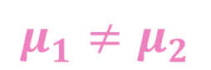
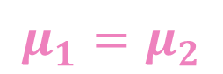
Hypotheses
In words, what are the two competing hypotheses in a two-sample t-test?
Null (H_{O})
“There is no difference in means between the two groups”
Alternate (H_{A})
“There is a difference in means between the two groups”
$$μ_{1}=μ_{2}$$
$$μ_{1}≠μ_{2}$$

Slide 5
Data properties
Two formal hypotheses in a t-test: equal means, or different means
Detecting “significant differences” depends on data properties:
Sample size
Effect size (true difference between group means)
Variability (spread) around the mean
Statistical frameworks help us test whether our observations are significant, given the properties of our data

Slide 6
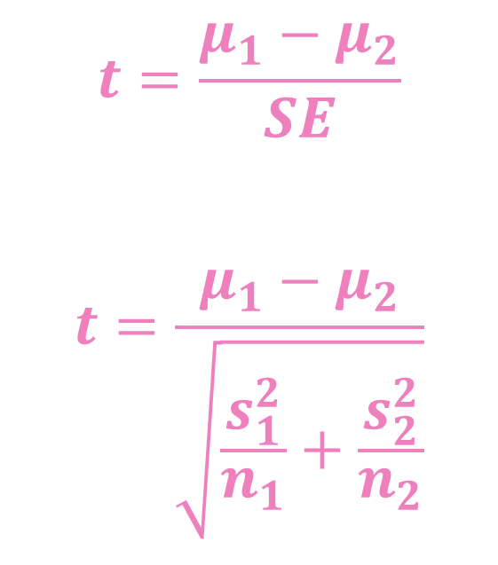
The t-statistic (two samples)
T-statistic captures difference in means (μ) between two groups (1 or 2)
Numerator: difference in means
Denominator: standard error
Calculation standardises the differences in mean by variance (s²) and sample sizes (n) in each respective group
$$t=\frac{μ_{1}−μ_{2}}{SE}$$
$$t=\frac{μ_{1}−μ_{2}}{\sqrt{\frac{s_{1}^{2}}{n_{1}}+\frac{s_{2}^{2}}{n_{2}}}}$$

Slide 7
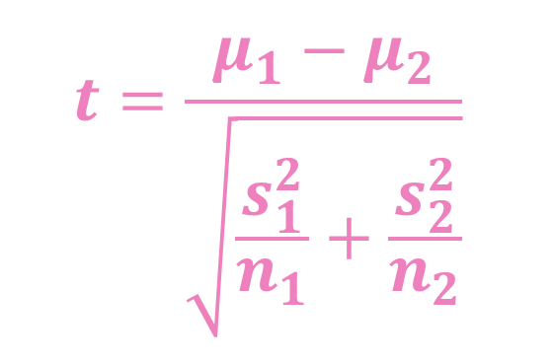
Assumptions
$$t=\frac{μ_{1}−μ_{2}}{\sqrt{\frac{s_{1}^{2}}{n_{1}}+\frac{s_{2}^{2}}{n_{2}}}}$$
Data is (approximately) normally distributed
Variance should be equal between groups (otherwise, have to do separate calculation to pool variances).

Slide 8
Simulation: Data properties
Open up R and load the StatsModules_2sample_t.R script (or cut-paste code)
We will simulate samples using the following parameters:
Sample size (n)
Effect size (eff), difference in means when H_{O} is false
Standard deviation (s)
library(ggplot2)
#### SNIPPET 1 ####
# Params:
# n = sample size (both groups)
# eff = effect size (negative or positive number)
# s = standard deviation
n <- 50
eff <- 1
s <- 1

Slide 9
Simulations: Group distributions
Use parameters to simulate samples from a normal distribution (rnorm)
Group X and Y0 have mean of 50
Group Y1 has a mean of 50 + effect size
#### SNIPPET 2 ####
# Two groups, x or y.
# Group y0 is Ho TRUE, and group y1 is Ho FALSE.
x <- rnorm(n=n, sd=s, mean=50)
y0 <- rnorm(n=n, sd=s, mean=50)
y1 <- rnorm(n=n, sd=s, mean=50+eff)
# Print object contents to screen, they contain
# simulated values.
x
y0
y1

Slide 10
Simulations: Visualise distributions
#### SNIPPET 3 ####
# Plotting
plot(ggplot(data.frame(vals=c(x,y0,y1)
, group=c(rep('x', n), rep('y0', n), rep('y1', n)))
, aes(x=vals, fill=group))
+ theme(legend.position='none'
, strip.text.x = element_text(face='bold'))
+ geom_histogram(colour='black')
+ geom_vline(xintercept=50, linetype='dashed', colour='black')
+ scale_fill_manual(values=c(x='#737373', y0='#d65cd4', y1='#51d5e1'))
+ facet_wrap(~ group, ncol=1)
+ labs(x='Values', y='Frequency')
)
Remember, this is simulated data: your plots might look different
Histograms show the frequency distribution of values in each group
Group X and Y0 are centred around 50
Group Y1 centred > 50

Slide 11
Simulations: t-statistics by hand
We have 2 scenarios:
H_{O} is true (X vs Y0)
H_{O} is false (X vs Y1)
Calculate standard error in each of the scenarios
Calculate mean of groups
Calculate t-statistic for each of the scenarios
#### SNIPPET 4 ####
# Functions:
# sqrt() = calcualtes square root
# sd() = calculates the standard deviation
# Remember that SD^2 = variance
se0 <- sqrt((sd(x)^2/n)+(sd(y0)^2/n))
se1 <- sqrt((sd(x)^2/n)+(sd(y1)^2/n))
# Means
x.mean <- mean(x)
y0.mean <- mean(y0)
y1.mean <- mean(y1)
# Observed t-scores
t0 <- (x.mean-y0.mean-0)/se0
t1 <- (x.mean-y1.mean-0)/se1

Slide 12
Simulations: Significance testing
We will use a two-tailed test of statistical significance
Important concepts:
The expected value of t-statistics in each scenario
The probability of observing t, if H_{O} was true
#### SNIPPET 5 ####
# Take a look at the simulated t-statistics
t0
t1
# P-value: Probability of observing t if Ho = TRUE,
# given the number of degree of freedom (df).
# Two-tailed test
# p-value: simulated difference is 0 (Ho = TRUE).
2*(1-pt(abs(t0), df=n+n-2, lower.tail=TRUE))
# p-value: simulated difference isn't 0 (Ho = FALSE).
2*(1-pt(abs(t1), df=n+n-2, lower.tail=TRUE))

Slide 13
Observed (vs expected) t-statistics
Take a moment to reflect on the t-statistic observed in these datasets
# Take a look at the simulated t-statistics
t0
t1
What values of t would you expect to obtain when the null is true (t0) or false (t1)?
t0 should be close to zero (X and Y0 simulated to have the same means)
t1 should be different from zero (X and Y1 simulated to have different means)
Values of t-statistics depend on the data’s properties: rerun simulations multiple times Code Snippet 1 → 5 to observe how random variability affects the observed value of t

Slide 14
Probability of t, if H_{O} is true
Is the observed t-statistic likely to have arisen from a scenario where the H_{O} is true?
Can conclude statistical significance of different means when probability of observed t (the p-value) is low, if H_{O} were true
p(t0) > 0.05: accept H_{O}
p(t1) < 0.05: reject H_{O}
# Two-tailed test
# p-value: simulated difference is 0 (Ho = TRUE).
2*(1-pt(abs(t0), df=n+n-2, lower.tail=TRUE))
# p-value: simulated difference isn't 0 (Ho = FALSE).
2*(1-pt(abs(t1), df=n+n-2, lower.tail=TRUE))

Slide 15
Sample size, effect size, & SD (I)
Effect size. The difference in means when H_{O} is false
Edit Code Snippet 1: change eff = 0.025
Rerun all code from Code Snippet 1 → 5.
The p-value for t1 will almost certainly be > 0.05
Even though there is a true difference (X vs Y1), the effect is too small to detect
n <- 50
eff <- 0.025
s <- 1
2*(1-pt(abs(t1), df=n+n-2, lower.tail=TRUE))
[1] 0.4494341
Reflect on how the distribution of values, and observed t-statistics for the alternate scenario (t1) differ between this simulation (small effect size) and the original simulation (larger effect size).

Slide 16
Sample size, effect size, & SD (II)
Sample size. Larger sample sizes help us detect differences when the effect size is very small.
Edit Code Snippet 1: change n = 20,000
Rerun all code from Code Snippet 1 → 5
The p-value for t1 will almost certainly be < 0.05
With increasing sample size, there is increasing power to detect significant differences in group means
n <- 20000
eff <- 0.025
s <- 1
2*(1-pt(abs(t1), df=n+n-2, lower.tail=TRUE))
[1] 0.004425624

Slide 17
Sample size, effect size, & SD (III)
Standard deviation. Spread around the mean. Larger SD within groups increases potential overlap in distributions between groups.
Edit Code Snippet 1: reset n = 50, and eff = 1, but make SD very large, set s = 10
Rerun all code from Code Snippet 1 → 5
The p-value for t1 will almost certainly be > 0.05
Large SD makes it harder to distinguish two groups – and therefore, harder to reject H_{O} even when it is false
n <- 50
eff <- 1
s <- 10
2*(1-pt(abs(t1), df=n+n-2, lower.tail=TRUE))
[1] 0.5921636

Slide 18
Play time!
Edit parameters n, eff, and s from Code Snippet 1 and see how they affect the outcome of your analyses
Questions to ponder:
If the standard deviation is very large, what increases your ability to detect truly significant differences between X and Y1?
If the effect size is small, and the sample size is also small, what increases your ability to detect a truly significant difference between X and Y1?
How does a negative effect size (eff < 0) change (or not change) the calculated t-statistic and the test of significance?

Slide 19
Recap
You should now be able to:
Explain how t-statistics are used to test hypotheses about group differences
Apply t-statistic calculations to real data and interpret the significance of results
Evaluate how sample size, effect size, and standard deviation affect the ability to detect (truly) significant differences between groups
Use R to simulate and analyse data

